Slide 1

AWS Architecture Icons
FOR DARK BACKGROUNDS
Release 3.0-2019.05.21

Slide 2
Release 3.0-2019.05.21: What’s new?
For the latest deck, asset packages, or resources, visit the AWS Architecture Center: https://aws.amazon.com/architecture/icons/
Updates to existing icons Amazon Chime icon adjusted AWS PrivateLink name changed AWS VPN icon is now AWS Client VPN
Category changes Desktop & App Streaming is now the End User Computing category AWS Organizations: Management & Governance Elastic Load Balancing: Networking & Content Delivery
Additional product icons Amazon WorkLink AWS Deep Learning Containers AWS Site-to-Site VPN
Additional resource icons AWS IoT Greengrass – Connector AWS IoT Analytics – Data Set and Notebook Amazon Rekognition – Image and Video Streams AWS DataSync – Agent Amazon API Gateway – Endpoint Elastic Load Balancing – Application, Classic, and Network Load Balancers Amazon Elastic File System – File system

Slide 3
Contents
Introduction
System
Guidelines
Elements
Examples

Slide 4

Introduction
About the deck, and guidance for getting started

Slide 5






About AWS Architecture Icons
Architecture diagrams are a great way to communicate your design, deployment and topology. In this deck, you will find an official collection of AWS product icons, resources, and other tools to help you build customer-focused and consistent AWS Architecture diagrams.
Customers and partners are permitted by AWS to use the icons to create architecture diagrams. They are designed to be simple so that you can easily incorporate them in your diagrams and put them in your whitepapers, presentations, datasheets, posters, or any technical material you like.
AWS Cloud
Availability Zone 1
Availability Zone 2
VPC
NAT Gateway
Amazon EC2 Auto Scaling
NAT Gateway
Auto Scaling group
Instance
Instance
Auto Scaling group
Instance
Instance

Slide 6
Before you begin:
1
2
3
Check for the
latest deck update
Read the guidelines
When in doubt,
see the examples
For specific element guidance and best practices, see the guidelines.
Download the
latest deck from the
AWS Architecture Center
For completed diagrams, jump to the example pages for completed diagrams. If you’re having trouble with a particular layout or object, use these as a blueprint.

Slide 7
System
An all-up look at the diagram system

Slide 8




System elements
AWS Cloud
Groups
Arrows
Product icons
Show the connection between multiple products or resources
Describe a flow of information or connect different parts of a diagram
Represents an AWS product or service
Resource icons
General resource icons
Represents an AWS product resource
Apply to multiple products or categories

Slide 9
System elements
Group icon
AWS Cloud
Layered groups
Availability Zone 1
Availability Zone 2
VPC
Product icon
NAT Gateway
Amazon EC2 Auto Scaling
NAT Gateway
Auto Scaling group
Instance
Instance
Resource icon
Auto Scaling group
Instance
Instance

Slide 10
Guidelines
Diagram and element guidance

Slide 11
Building a diagram
Choose your deck style The architecture deck is available for both light and dark backgrounds. Determine which best fits your need – light backgrounds tend to be used on the web, whereas dark backgrounds are used for in-person presentations or slide decks.
Start with the structure Locate the groups you’ll to for the underlying structure of your diagram.
Add product and resource icons Navigate to the category of your desired product icon or resource, or use the search capability to locate it. Then, copy and paste it into your diagram.
Add other steps Does your diagram include external users or devices? Use resources to add depth or context to your diagram.
Connect the steps Use the preset arrows to connect your steps and describe a workflow.

Slide 12
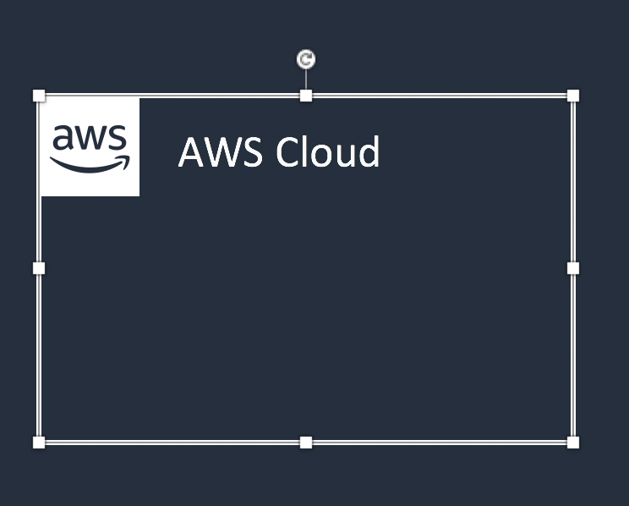


Groups
Each group consists of an icon and a label. Colors and lines help differentiate groups to make it easier for the user to read a diagram at a glance. Some groups cross multiple other groups, such as Auto Scaling, whereas others are meant to layer inside one another, such as VPC and subnets.
Resizing groups
Layering groups
Use the bottom right corner of a group box to stretch or collapse to your desired size.
When you have groups within groups, each inner group should have about 0.05” buffer on each side.
DO:
Hold Shift down while resizing an icon to maintain a square
Use a generic group type if the presets do not suit your needs
VPC
Public subnet
DON’T:
Create new group icons

Slide 13



Icons
Primary product and resource icons are designed to be used on both dark and light backgrounds. Alternate product icons are specific to a background type. All icons may be renamed to better fit your use case.
Resizing icons
Using the alternate product icon
All icons in this deck are SVGs, allowing them to be scaled up or down depending on the diagram. To preserve icon integrity, be sure to hold down Shift while resizing.
DO:
In some complex diagrams, it may be less visually distracting to use the alternate “light-bg” product icons. These are built with a solid color background instead of a gradient and may be used interchangeably at your discretion.
Hold Shift down while resizing
Change the resource icon text color when using a dark background
Use the alternate light-bg product icon when appropriate
DON’T:
Crop product icons
Flip or rotate icons
Change icon shapes
Amazon-Lex.svg
Amazon-Lex_light-bg.svg

Slide 14
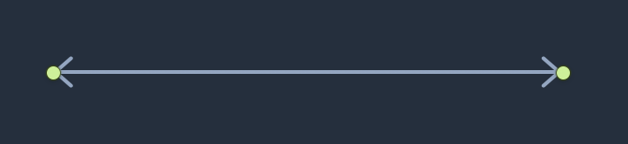
Arrows
Use arrows or lines to connect parts of a diagram or to show a workflow.
Use preset arrows
Create new arrows
Copy the preset arrows into your diagram to maintain correct formatting. To edit, click on the arrow, hold down Shift.
Preset arrows use the “Open Arrow” in Size 4.
DO:
Use the preset arrows provided in the Elements section
Use straight lines and right angles to connect objects
Default Arrow
+ Open Arrow
+ Size 4
When in doubt, use the default
DON’T:
Hold Shift
If the arrow shape you need is not available in the sample arrows, go ahead and use the default arrows.
Create diagonal lines
Use anything beside preset or default arrows

Slide 15

Text boxes
Product and icon names are separated from the icon itself to allow for adjustment or abbreviation. You may change the size or color of the text, or use the short form of the product name if necessary.
Name wrapping and line breaks
AWS product names should fit on one or two lines. AWS or Amazon should always be accompanied by the product name. Lines should never break mid-word.
DO:
Modify color or text size if necessary
Break a line after the second word in the product name
Amazon Elasticsearch Service
Amazon
Elasticsearch Service
Amazon
Elastic-
search Service
DON’T:
Amazon should be on the same line as the first word in the product name
Use short forms without first mentioning the full product name
Duplicate short forms for different products, i.e., ELB for Elastic Beanstalk and Elastic Load Balancing
Break a line in the middle of a word
Lines should never break mid-word
Should fit on 2 lines max
Short forms
If you are using a product multiple times in a diagram, you may use the short form or abbreviation instead of the full product name to save space.

Slide 16
Elements
Groups, arrows, resource icons, and product icons to use when building your diagram

Slide 17
Icon categories
Click a category to jump to slide (must be in Presentation mode)
General Resources
Analytics
Application Integration
AR & VR
AWS Cost Management
Blockchain
Business Applications
Compute
Customer Engagement
Database
Developer Tools
End User Computing
Game Tech
Internet of Things
Machine Learning
Management & Governance
Media Services
Migration & Transfer
Mobile
Networking & Content Delivery
Robotics
Satellite
Security, Identity, & Compliance
Storage

Slide 18
General resources

Slide 19








Groups
1/3
AWS Cloud
AWS Cloud
Region
Availability Zone
Security group
Auto Scaling group
VPC
Private subnet
Public subnet
Server contents
Corporate data center
Elastic Beanstalk container
EC2 instance contents
Spot Fleet
AWS Step Functions workflow
Generic group
Generic group

Slide 20
Arrows
2/3

Slide 21

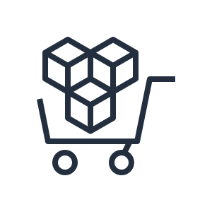


















General icons
3/3
AWS Marketplace
AWS Marketplace
Client
Disk
Forums
Generic database
Internet
Internet alt1
Internet alt2
Mobile client
Multimedia
Office building
SAML token
SSL padlock
Tape storage
Traditional server
User
Users
Toolkit
SDK

Slide 22


Analytics

Slide 23




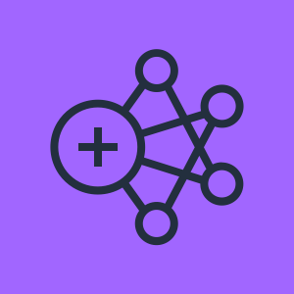


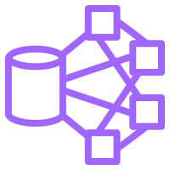
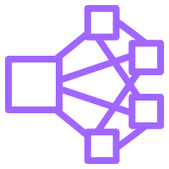

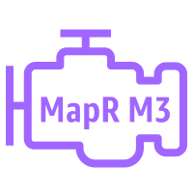
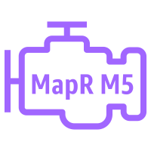

Analytics
1/4
Amazon CloudSearch
Amazon EMR
Amazon Kinesis
Amazon CloudSearch
Amazon EMR
Amazon Kinesis
Search documents
HDFS cluster
Cluster
EMR engine
EMR engine MapR M3
EMR engine MapR M5
EMR engine MapR M7

Slide 24








Analytics
2/4
Amazon Kinesis
Video Streams
Amazon Kinesis
Data Streams
Amazon Kinesis
Data Firehose
Amazon Kinesis
Data Analytics
Amazon Kinesis
Video Streams
Amazon Kinesis
Data Streams
Amazon Kinesis
Data Firehose
Amazon Kinesis
Data Analytics

Slide 25








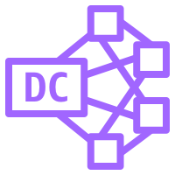

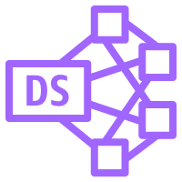
Analytics
3/4
AWS Glue
Amazon Athena
Amazon Elasticsearch Service
Amazon Redshift
AWS Glue
Amazon Athena
Amazon Elasticsearch Service
Amazon Redshift
Crawler
Dense compute node
Data Catalog
Dense storage node

Slide 26








Analytics
4/4
Amazon QuickSight
AWS Lake Formation
AWS Data Pipeline
Amazon Managed Streaming for Kafka
Amazon QuickSight
AWS Lake Formation
AWS Data Pipeline
Amazon Managed Streaming for Kafka

Slide 27


Application Integration

Slide 28



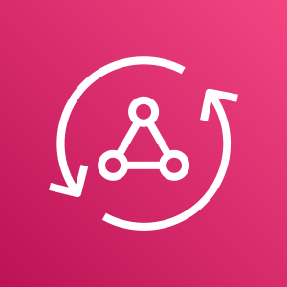









Application Integration
1/2
Amazon Simple Notification Service
Amazon Simple Queue Service
Amazon MQ
AWS AppSync
Amazon Simple Notification Service
Amazon Simple Queue Service
Amazon MQ
AWS AppSync
Email notification
Message
HTTP notification
Queue
Topic

Slide 29


Application Integration
2/2
AWS Step Functions
AWS Step Functions

Slide 30


AR & VR

Slide 31


AR & VR
1/1
Amazon Sumerian
Amazon Sumerian

Slide 32


AWS Cost Management

Slide 33








AWS Cost Management
1/1
AWS Budgets
AWS Cost and Usage Report
AWS Cost Explorer
Reserved Instance Reporting
AWS Budgets
AWS Cost and Usage Report
AWS Cost Explorer
Reserved Instance Reporting

Slide 34


Blockchain

Slide 35




Blockchain
1/1
Amazon Managed Blockchain
Amazon Quantum Ledger Database (QLDB)
Amazon Managed Blockchain
Amazon Quantum Ledger Database (QLDB)

Slide 36


Business Applications

Slide 37






Business Applications
1/1
Alexa for Business
Amazon Chime
Amazon WorkMail
Alexa for Business
Amazon Chime
Amazon WorkMail

Slide 38


Compute

Slide 39





















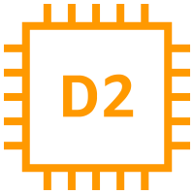



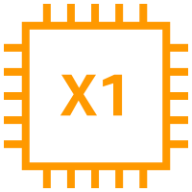





Compute
1/5
AMI
Auto Scaling
Elastic IP Address
Rescue
Amazon EC2
Instance
A1 instance
M4 instance
R5a instance
z1d instance
H1 instance
Amazon EC2
Instances
T3 instance
C5 instance
R4 instance
P3 instance
I3 instance
Spot instance
T2 instance
C5n instance
X1e instance
P2 instance
D2 instance
Instance with CloudWatch
M5 instance
C4 instance
X1 instance
G3 instance
M5a instance
R5 instance
High Memory instance
F1 instance
DB on instance

Slide 40












Compute
2/5
Amazon EC2 Auto Scaling
Amazon Elastic Container Registry
Amazon Elastic Container Service
Amazon EC2 Auto Scaling
Amazon Elastic Container Registry
Amazon Elastic Container Service
Registry
Container 1
Container 2
Container 3
Image
Task
Service

Slide 41











Compute
3/5
AWS Elastic Beanstalk
AWS Lambda
Amazon Elastic Container Service for Kubernetes
Amazon Lightsail
AWS Elastic Beanstalk
AWS Lambda
Amazon Elastic Container Service for Kubernetes
Amazon Lightsail
Deployment
Lambda function
Application

Slide 42








Compute
4/5
AWS Fargate
AWS Outposts
AWS Serverless Application Repository
AWS Batch
AWS Fargate
AWS Outposts
AWS Serverless Application Repository
AWS Batch

Slide 43


Compute
5/5
VMware Cloud on AWS
VMware Cloud on AWS

Slide 44


Customer Engagement

Slide 45







Customer Engagement
1/1
Amazon Connect
Amazon Pinpoint
Amazon Simple Email Service (SES)
Amazon Connect
Amazon Pinpoint
Amazon Simple Email Service (SES)
Email

Slide 46


Database

Slide 47

















Database
1/3
Amazon Aurora
Amazon DocumentDB (with MongoDB compatibility)
Amazon DynamoDB
Amazon ElastiCache
Amazon Aurora
Amazon DocumentDB (with MongoDB compatibility)
Amazon DynamoDB
Amazon ElastiCache
Attribute
Items
Cache node
Item
Table
ElastiCache for Redis
ElastiCache for Memcached
Attributes
Global secondary index

Slide 48


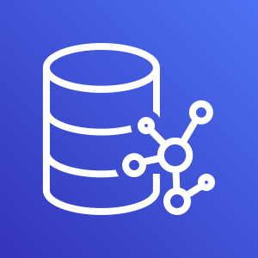





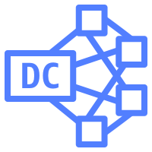

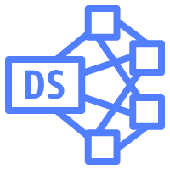
Database
2/3
Amazon Redshift
AWS Database Migration Service
Amazon Neptune
Amazon Quantum Ledger Database (QLDB)
Amazon Redshift
AWS Database Migration Service
Amazon Neptune
Amazon Quantum Ledger Database (QLDB)
Dense compute node
Database migration workflow/job
Dense storage node

Slide 49


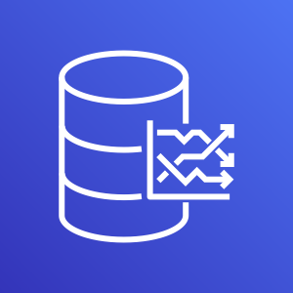



Database
3/3
Amazon RDS
Amazon RDS on VMware
Amazon Timestream
Amazon RDS
Amazon RDS on VMware
Amazon Timestream

Slide 50


Developer Tools

Slide 51








Developer Tools
1/3
AWS Cloud9
AWS CodeBuild
AWS CodeCommit
AWS CodeDeploy
AWS Cloud9
AWS CodeBuild
AWS CodeCommit
AWS CodeDeploy

Slide 52



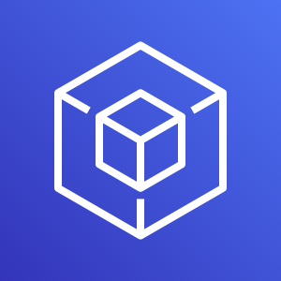




Developer Tools
2/3
AWS CodePipeline
AWS CodeStar
AWS Command Line Interface
AWS Tools and SDKs
AWS CodePipeline
AWS CodeStar
AWS Command Line Interface
AWS Tools and SDKs

Slide 53


Developer Tools
3/3
AWS X-Ray
AWS X-Ray

Slide 54


End User Computing

Slide 55

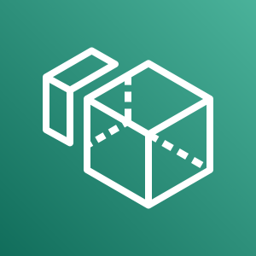



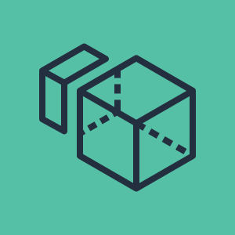


End User Computing
1/1
Amazon AppStream 2.0
Amazon WorkSpaces
Amazon WorkLink
Amazon WorkDocs
Amazon AppStream 2.0
Amazon WorkSpaces
Amazon WorkLink
Amazon WorkDocs

Slide 56


Game Tech

Slide 57


Game Tech
1/1
Amazon GameLift
Amazon GameLift

Slide 58


Internet of Things

Slide 59













Internet of Things
2/3
Amazon FreeRTOS
AWS IoT 1-Click
AWS IoT Analytics
AWS IoT Button
Amazon FreeRTOS
AWS IoT 1-Click
AWS IoT Analytics
AWS IoT Button
Channel
Data set
Pipeline
Notebook
Data store

Slide 60








Internet of Things
2/3
AWS IoT Core
AWS IoT Device Defender
AWS IoT Device Management
AWS IoT Events
AWS IoT Core
AWS IoT Device Defender
AWS IoT Device Management
AWS IoT Events

Slide 61






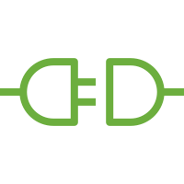
Internet of Things
2/3
AWS IoT Greengrass
AWS IoT SiteWise
AWS IoT Things Graph
AWS IoT Greengrass
AWS IoT SiteWise
AWS IoT Things Graph
Connector

Slide 62










































Internet of Things
4/4
IoT action
IoT actuator
IoT certificate
IoT desired state
IoT hardware board
IoT HTTP protocol
IoT HTTP/2 protocol
IoT MQTT protocol
IoT policy
IoT reported state
IoT rule
IoT sensor
Device gateway
IoT servo
IoT
shadow
IoT simulator
IoT topic
Alexa skill
Alexa voice service
Alexa enabled device
Echo
Fire TV
Fire TV stick
Lambda function
Over-the-air update
IoT thing bank
IoT thing bicycle
IoT thing camera
IoT thing car
IoT thing cart
IoT thing coffee pot
IoT thing door lock
IoT thing factory
IoT thing generic
IoT thing house
IoT thing lightbulb
IoT thing medical emergency
IoT thing police emergency
IoT thing thermostat
IoT thing travel
IoT thing utility
IoT thing windfarm

Slide 63


Machine Learning

Slide 64







Machine Learning
1/5
Amazon Comprehend
Amazon Elastic Inference
Amazon Forecast
Amazon Lex
Amazon Comprehend
Amazon Elastic Inference
Amazon Forecast
Amazon Lex

Slide 65













Machine Learning
2/5
Amazon Personalize
Amazon Polly
Amazon Rekognition
Amazon SageMaker
Amazon Personalize
Amazon Polly
Amazon Rekognition
Amazon SageMaker
Notebook
Rekognition image
Model
Rekognition video
Train

Slide 66








Machine Learning
3/5
Amazon SageMaker Ground Truth
Amazon Textract
Amazon Transcribe
Amazon Translate
Amazon SageMaker Ground Truth
Amazon Textract
Amazon Transcribe
Amazon Translate

Slide 67








Machine Learning
4/5
Apache MXNet on AWS
AWS Deep Learning AMIs
AWS DeepLens
AWS DeepRacer
Apache MXNet on AWS
AWS Deep Learning AMIs
AWS DeepLens
AWS DeepRacer

Slide 68


Machine Learning
5/5
TensorFlow on AWS
AWS Deep Learning Containers
TensorFlow on AWS
AWS Deep Learning Containers

Slide 69


Management & Governance

Slide 70















Management & Governance
1/5
Amazon CloudWatch
AWS Auto Scaling
AWS CloudFormation
AWS CloudTrail
Amazon CloudWatch
AWS Auto Scaling
AWS CloudFormation
AWS CloudTrail
Alarm
Event (time-based)
Change set
Stack
Event
(event-based)
Rule
Template

Slide 71








Management & Governance
2/5
AWS Command Line Interface
AWS Config
AWS License Manager
AWS Managed Services
AWS Command Line Interface
AWS Config
AWS License Manager
AWS Managed Services

Slide 72










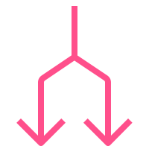



Management & Governance
3/5
AWS Management Console
AWS OpsWorks
AWS Personal Health Dashboard
AWS Management Console
AWS OpsWorks
AWS Personal Health Dashboard
Apps
Instances
Monitoring
Permissions
Deployments
Layers
Resources
Stack2

Slide 73












Management & Governance
4/5
AWS Service Catalog
AWS Systems Manager
AWS Service Catalog
AWS Systems Manager
Automation
Documents
Patch Manager
Parameter Store
Inventory
Maintenance Windows
State Manager
Run Command

Slide 74











Management & Governance
5/5
AWS Trusted Advisor
AWS Well-Architected Tool
AWS Control Tower
AWS Trusted Advisor
AWS Well-Architected Tool
AWS Control Tower
Checklist cost
Checklist performance
Checklist security
Checklist fault tolerant
Checklist

Slide 75


Media Services

Slide 76








Media Services
1/2
Amazon Elastic Transcoder
Amazon Kinesis Video Streams
AWS Elemental MediaConnect
AWS Elemental MediaLive
Amazon Elastic Transcoder
Amazon Kinesis Video Streams
AWS Elemental MediaConnect
AWS Elemental MediaLive

Slide 77








Media Services
2/2
AWS Elemental MediaConvert
AWS Elemental MediaPackage
AWS Elemental MediaStore
AWS Elemental MediaTailor
AWS Elemental MediaConvert
AWS Elemental MediaPackage
AWS Elemental MediaStore
AWS Elemental MediaTailor

Slide 78


Migration and Transfer

Slide 79









Migration and Transfer
1/3
AWS Application Discovery Service
AWS Database Migration Service
AWS DataSync
AWS Migration Hub
AWS Application Discovery Service
AWS Database Migration Service
AWS DataSync
AWS Migration Hub
Agent

Slide 80








Migration and Transfer
2/3
AWS Server Migration Service
AWS Transfer for SFTP
AWS Snowball
AWS Snowball Edge
AWS Server Migration Service
AWS Transfer for SFTP
AWS Snowball
AWS Snowball Edge

Slide 81
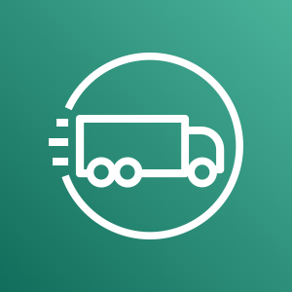
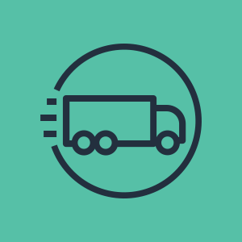
Migration and Transfer
3/3
AWS Snowmobile
AWS Snowmobile

Slide 82


Mobile

Slide 83



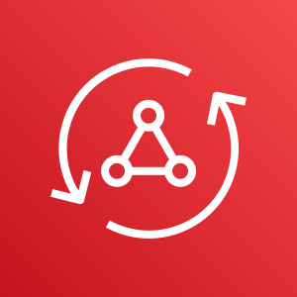





Mobile
1/2
Amazon API Gateway
Amazon Pinpoint
AWS Amplify
AWS AppSync
Amazon API Gateway
Amazon Pinpoint
AWS Amplify
AWS AppSync
Endpoint

Slide 84


Mobile
2/2
AWS Device Farm
AWS Device Farm

Slide 85


Networking & Content Delivery

Slide 86












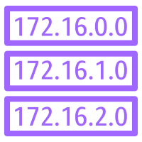

Networking & Content Delivery
1/4
Amazon API Gateway
Amazon CloudFront
Amazon Route 53
AWS PrivateLink
Amazon API Gateway
Amazon CloudFront
Amazon Route 53
AWS PrivateLink
Download distribution
Endpoint
Hosted zone
Edge location
Route table
Streaming distribution

Slide 87













Networking & Content Delivery
2/4
Amazon VPC
Amazon VPC
Customer gateway
Elastic Network Adapter
Endpoints
Internet gateway
Router
VPN gateway
Elastic network interface
NAT gateway
Flow logs
Network access control list
VPN connection
Peering

Slide 88




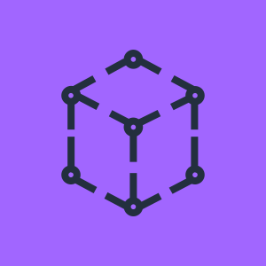



Networking & Content Delivery
3/4
AWS App Mesh
AWS Cloud Map
AWS Direct Connect
AWS Global Accelerator
AWS App Mesh
AWS Cloud Map
AWS Direct Connect
AWS Global Accelerator

Slide 89











Networking & Content Delivery
4/4
AWS Transit Gateway
AWS Client VPN
AWS Site-to-Site VPN
Elastic Load Balancing
AWS Transit Gateway
AWS Client VPN
AWS Site-to-Site VPN
Elastic Load Balancing
Application Load Balancer
Classic Load Balancer
Network Load Balancer

Slide 90


Robotics

Slide 91






Robotics
1/1
AWS RoboMaker
AWS RoboMaker
Fleet management
Development environment
Cloud extensions ROS
Simulation

Slide 92


Satellite

Slide 93


Satellite
1/1
AWS Ground Station
AWS Ground Station

Slide 94


Security, Identity, & Compliance

Slide 95









Security, Identity and Compliance
1/5
Amazon Cloud Directory
Amazon Cognito
Amazon GuardDuty
Amazon Inspector
Amazon Cloud Directory
Amazon Cognito
Amazon GuardDuty
Amazon Inspector
Agent

Slide 96









Security, Identity and Compliance
2/5
Amazon Macie
AWS Artifact
AWS Certificate Manager
AWS CloudHSM
Amazon Macie
AWS Artifact
AWS Certificate Manager
AWS CloudHSM
Certificate Manager

Slide 97
















Security, Identity and Compliance
3/5
AWS Directory Service
AWS Firewall Manager
AWS Identity and Access Management (IAM)
AWS Directory Service
AWS Firewall Manager
AWS Identity and Access Management (IAM)
Add-on
AWS STS
MFA token
Long-term security credential
AWS STS (alternate)
Permissions
Encrypted data
Temporary security credential
Data encryption key
Role

Slide 98









Security, Identity and Compliance
4/5
AWS Key Management Service
AWS Secrets Manager
AWS Security Hub
AWS Shield
AWS Key Management Service
AWS Secrets Manager
AWS Security Hub
AWS Shield
AWS Shield Advanced

Slide 99





Security, Identity and Compliance
5/5
AWS Single Sign-On
AWS WAF
AWS Single Sign-On
AWS WAF
Filtering rule

Slide 100


Storage

Slide 101
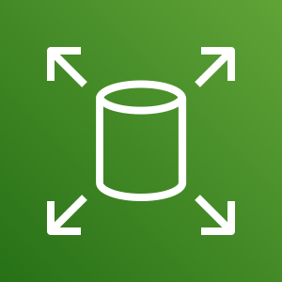










Storage
1/3
Amazon Elastic Block Store (EBS)
Amazon Elastic File System
Amazon FSx
Amazon FSx for Lustre
Amazon Elastic Block Store (EBS)
Amazon Elastic File System
Amazon FSx
Amazon FSx for Lustre
Snapshot
File system
Volume

Slide 102














Storage
2/3
Amazon FSx for Windows File Server
Amazon Simple Storage Service (S3)
Amazon S3 Glacier
AWS Snowball
Amazon FSx for Windows File Server
Amazon Simple Storage Service (S3)
Amazon S3 Glacier
AWS Snowball
Object
Bucket
Archive
Vault
Snowball import-export
Bucket with objects

Slide 103

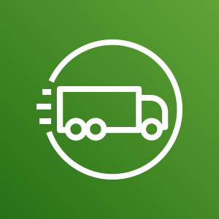



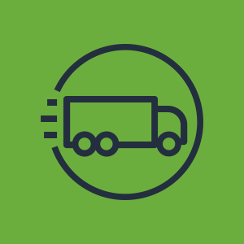





Storage
3/3
AWS Snowball Edge
AWS Snowmobile
AWS Backup
AWS Storage Gateway
AWS Snowball Edge
AWS Snowmobile
AWS Backup
AWS Storage Gateway
Non-cached volume
Cached volume
Virtual tape library

Slide 104
Examples
The system in action

Slide 105
Example:
Git to S3 Webhooks
AWS Cloud
Amazon S3 SSH Key bucket
Git push
Third-party Git repository
Git webhook
Git users
AWS KMS key
AWS Lambda
AWS Lambda
Amazon S3 output bucket

Slide 106

Example:
Chef Automate Architecture on AWS
AWS Cloud
Availability Zone
VPC
Internet gateway
Public subnet
Knife is used to upload cookbooks
Knife is used to bootstrap and communicate with nodes
Chef-client processes run-list
1
Chef Automate
3
2
Chef workstation (local Chef repo)
Chef node
10.0.0.0/19
10.0.0.0/16

